Slide 1


Understanding
Medicaid
July 2023

Slide 2
Objectives
Introduction
Texas Medicaid Eligibility
Applying for Texas Medicaid
Overview of Texas Medicaid
Medicaid HMO Plan Types
Definitions
Working with Medicaid HMOs
Questions and Answers
Resources

Slide 3
Disclaimer
This presentation is for educational and informational purposes only.
It is not intended as a substitute for professional advice or to endorse or promote any one healthcare program or company over others.
All content is current as of July 1, 2023, and is subject to change in the future.

Slide 4
Introduction
Medicaid provides health coverage to millions of Americans who qualify, including low-income adults, children, pregnant women, elderly adults and people with disabilities.
Medicaid is administered by states, according to federal requirements. The program is funded both by states and the federal government.
In Texas, the Health and Human Services Commission (HHSC):
    Oversees Medicaid policy;
    Determines client eligibility;
    Oversees provider and health plan contracts;
    Submits Medicaid State Plan documents to the federal Centers for Medicare and Medicaid Services.
Reference: https://www.medicaid.gov/medicaid/index.html

Slide 5
Texas Medicaid Eligibility
To be eligible for Texas Medicaid, you must be a Texas resident, a U.S. national, citizen, permanent resident, or legal alien in need of health care and insurance assistance.
You must also meet one of the following qualifications:
  You’re pregnant; or
  You’re responsible for a child 18 years of age or younger; or
  You’re blind; or
  You have a disability, or a family member in your household has a disability; or
  You’re 65 years of age or older.
Lastly, your financial situation would be characterized as low income or very low income (changes each year – see next slide).
Reference: https://www.benefits.gov/benefit/1640%7D

Slide 6
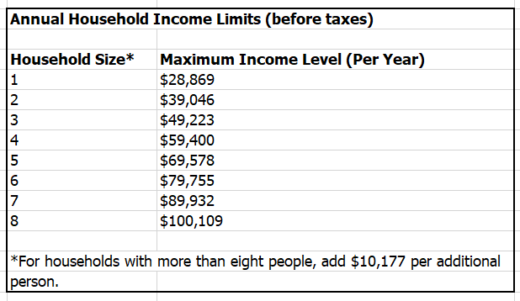
Texas Medicaid Eligibility
Your financial situation would be characterized as low income or very low income. For 2023, this means:
  Reference: https://www.benefits.gov/benefit/1640%7D

Slide 7
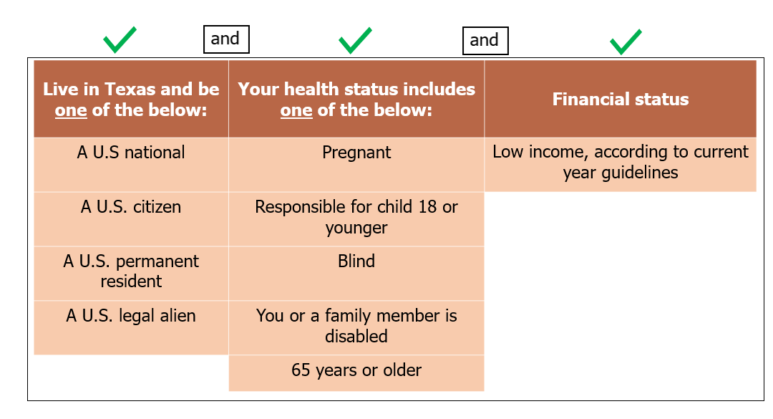
Texas Medicaid Eligibility

Slide 8
Applying for Texas Medicaid
You can apply for Medicaid in one of these ways:
  Online at https://www.yourtexasbenefits.com/Learn/Home# >> Apply for New Benefits
  Call the Texas Enrollment Broker Helpline at 2-1-1 (select Option 2 after picking a language) Monday through Friday from 8am to 6pm.
    If 2-1-1 is experiencing technical difficulties, call 800-964-2777.
  Print or request a paper form and submit it by mail: https://www.yourtexasbenefits.com/Learn/GetPaperForm
  Find and visit a Community Partner near you: https://www.texascommunitypartnerprogram.com/

Slide 9
Applying for Texas Medicaid
Whichever way you choose to apply, you will need this information at a minimum for anyone who is applying for benefits:
  Social Security number and birth date
  Citizenship or immigration status
  Money from your job and other sources
  The value of cars and other property
  Costs you pay for bills
  For a specific list of other information you will need, please see this link and review the requirements under the third column called Health Care: https://www.yourtexasbenefits.com/GeneratePDF/StaticPdfs/en_US/M5017_March2021.pdf

Slide 10
Applying for Texas Medicaid
It takes 45-90 calendar days for HHSC to approve an initial application for Medicaid.
  You can check status of your application online at https://www.yourtexasbenefits.com/Learn/Home# or by calling the Texas Enrollment Broker Helpline at 2-1-1 (800-964-2777), select Option 2 after picking a language.
After you’re approved for Medicaid, you are initially enrolled into Traditional Medicaid.
  People enrolled in Medicaid are called clients.

Slide 11
Applying for Texas Medicaid
Medicaid offers coverage for a full range of health care benefits with a focus on prevention, wellness and care coordination. Examples of covered services under Medicaid include (not limited to):
  Doctor visits
  Vaccines
  Prescription drugs
  Vision, hearing, and dental care
  Emergency services
  X-rays and laboratory tests
  Hospital inpatient and outpatient care
  Prenatal care and childbirth
For more details, review the Texas Medicaid Reference Guide: https://www.hhs.texas.gov/sites/default/files/documents/texas-medicaid-chip-reference-guide-14th-edition.pdf

Slide 12
Overview of Texas Medicaid
Effective 3/1/2012: the State of Texas began transitioning most Medicaid client’s care into a Medicaid HMO.
A Medicaid HMO is a private company that offers health plans that cover the same services as Traditional Medicaid. A Medicaid HMO has its own network of doctors and hospitals.
Watch your mail! Soon after Medicaid benefits are approved, most clients will receive a letter that indicates they must choose a Medicaid HMO by a certain date.
  If a Medicaid HMO is not chosen, clients will automatically be enrolled into one.
Clients who enroll in a Medicaid HMO get all of their services from the doctors and hospitals that are in the network.
Medicaid HMOs offer the same benefits and follow the same rules as Traditional Medicaid.
Traditional Medicaid continues to serve clients when Medicaid HMOs are not available.

Slide 13

Traditional Medicaid vs. Medicaid HMO

Slide 14

Traditional Medicaid vs. Medicaid HMO

Slide 15
Medicaid HMO Plan Types
In Texas, there are four Medicaid HMO plan types (also known as plans or programs). The type of Medicaid HMO plan clients are enrolled into depends on certain factors.
State of Texas Access Reform (STAR)
STAR+PLUS
STAR Kids
STAR Health
Resource: https://www.hhs.texas.gov/services/questions-about-your-benefits

Slide 16
Medicaid HMO Plan Types
STAR | STAR+PLUS | STAR KIDS | STAR HEALTH
For clients who are not chronically ill or disabled. | For clients who are chronically ill or disabled. | For youth aged 20 years and younger who are chronically ill or disabled. | For children aged 18 and younger in the Texas Department of Family and Protective Services conservatorship;
STAR typically covers clients who receive Temporary Assistance for Needy Families, pregnant women, children and newborns. | Many times, clients under STAR+PLUS receive supplemental security income (SSI). | Clients must also receive SSI and meet certain other criteria. | For children in the Adoption Assistance or Permanency Care Assistance program who are transitioning from STAR Health to STAR or STAR Kids;
 |  |  | For youth aged 21 years and younger with voluntary extended foster care placement agreements (Extended Foster Care);
 |  |  | For youth aged 20 and younger who are Former Foster Care Children.
Resource: https://www.hhs.texas.gov/services/questions-about-your-benefits

Slide 17
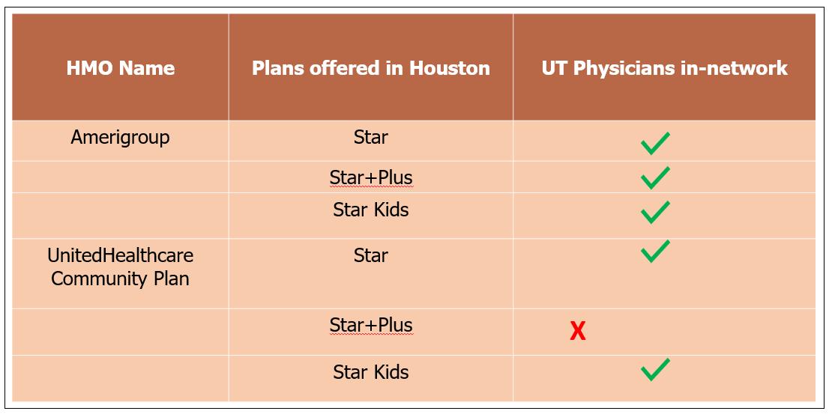
Medicaid HMO Plan Types
In Houston, some of the companies that offer STAR, STAR+PLUS and/or STAR Kids are:
  Amerigroup Superior HealthPlan
  Community Health Choice UnitedHealthcare Community Plan

Slide 18
Definitions
Primary care provider – The main doctor you will see for most of your regular health care.
  Primary care providers could be Family Practice, General Practice, Pediatrics, or Internal Medicine doctors.
Provider – Any doctor, mid-level practitioner, hospital, or other facility that provides health care services.
    Mid-level practitioner examples: Physician Assistant, Nurse Practitioner
    Other facility examples: Physical Therapy clinic, Radiology facility
Network – A group of providers that work with the Medicaid HMO to provide health care services for its clients.
    In-network – Providers who work with the Medicaid HMO.
    Out-of-network – Providers who don’t work with the Medicaid HMO.

Slide 19
Definitions
Referral – A referral is when your primary care provider sends you to another provider for care.
Authorization – An approval decision by your Medicaid HMO that a certain health care service, treatment plan, prescription drug, or durable medical equipment that you or your provider has requested is medically necessary.
  Examples of durable medical equipment: oxygen equipment, wheelchair, crutches, diabetic supplies.
  Your providers must obtain the authorizations prior to your receiving the requested service.
  Without authorization for services requiring it, the Medicaid HMO will not pay your provider.

Slide 20
Working with Medicaid HMOs
Once you are enrolled in a Medicaid HMO, your medical care is given from doctors and hospitals that are part of the HMO network.
All Medicaid HMOs require you to choose a primary care provider.
  If you don’t choose a primary care provider when you first enrolled in the plan, one will be chosen for you.
  Your primary care provider will refer you to specialists, other doctors, or hospitals when you need special care or services they can’t provide.
You will receive a medical ID card and a member handbook from your Medicaid HMO.
  The member handbook helps explain how your plan works.
You will not owe any money for any benefit that is covered under your Medicaid HMO plan.
Show your medical ID card at every doctor or hospital visit.

Slide 21
Questions and Answers
Do I have to keep enrolling for Medicaid benefits after I’m initially approved?
  Yes, you will need to re-apply for benefits each year. HHSC will send you a letter when it’s time to renew your benefits.
Does the area I live in affect the Medicaid HMOs available to me?
  Yes. The Medicaid HMO choices depend on where you live and the specific plan (STAR, STAR+Plus, STAR Kids, STAR Health) that you’re enrolled in. HHSC will send you a packet in the mail when it’s time to choose a Medicaid HMO. You will have at least two Medicaid HMO choices, and the packet will include information on the Medicaid HMOs.
How do I sign up for a Medicaid HMO?
  Call the Texas Enrollment Broker Helpline at 2-1-1 (800-964-2777), select Option 2 after picking a language, or online at https://www.yourtexasbenefits.com/Learn/Home#

Slide 22
Questions and Answers
How do I make sure that my current providers are in network with the Medicaid HMO I am choosing?
  You should ask your doctors which Medicaid HMOs they work with. You can also check the Medicaid HMO online provider directories.
  Important: You should also pay close attention to the specific plan. Not all providers might be in-network with all Medicaid HMO plans.
    For example: if you are eligible for a Medicaid HMO Star Plus plan and you are considering UnitedHealthcare Community Plan Star Plus, you should ask your doctors specifically, or look at the UnitedHealthcare Community Plan online directory, to confirm if they are in-network with UnitedHealthcare Community Plan Star Plus. See slide 17 as a reference.
How do I choose my primary care provider?
  Call your Medicaid HMO’s Member Services number. You can find the number on the back of your Medicaid HMO ID card, or you can use the Medicaid HMO website to find the number.

Slide 23
Questions and Answers
How do I change my primary care provider?
  Call your Medicaid HMO’s Member Services number. If you created an account on your Medicaid HMO patient portal, you may be able to change primary care providers that way, also.
How often can I change Medicaid HMOs?
  Once a month, if you like. Changes take between 15-45 calendar days.
How do I change Medicaid HMOs?
  Call the Texas Enrollment Broker Helpline at 2-1-1 (800-964-2777), select Option 2 after picking a language, or online at https://www.yourtexasbenefits.com/Learn/Home#

Slide 24
Questions and Answers
If I change Medicaid HMOs, will it provide me with the same benefits as my current plan?
  All Medicaid HMOs are required to cover the same services as Texas Medicaid. If you have a question on a specific benefit that you want to be sure is covered under the new Medicaid HMO, call the Texas Enrollment Broker Helpline at 2-1-1 (800-964-2777), select Option 2 after picking a language, and confirm.
If I change Medicaid HMOs, will there be any changes to my doctors?
  There could be. Not all doctors work with all Medicaid HMOs. Before you change Medicaid HMOs, you should ask your doctors which Medicaid HMOs they work with. You can also check the Medicaid HMO online provider directories.
  Important: You should also pay close attention to the specific plan. Not all providers might be in-network with all Medicaid HMO plans.
    For example: if you are eligible for a Medicaid HMO Star Plus plan and you are considering UnitedHealthcare Community Plan Star Plus, you should ask your doctors specifically, or look at the UnitedHealthcare Community Plan online directory, to confirm if they are in-network with UnitedHealthcare Community Plan Star Plus. See slide 17 as a reference.

Slide 25
Questions and Answers
If I change Medicaid HMOs, will it continue to provide vision, medication, and dental services?
  Yes. These are core benefits covered under all Medicaid HMOs.
How can I get help with navigating the Medicaid HMO patient website?
  Call your Medicaid HMO’s Member Services number.
What are some examples of non-covered services under Texas Medicaid, including Medicaid HMOs?
  Anything considered experimental or investigational, such as a new treatment being tested or hasn’t been shown to work
  Any surgery that isn’t medically necessary
  Infertility treatment services
  Private room and personal comfort items when hospitalized
  Reversal of voluntary sterilization
  Sex change surgery
If I decided to have a non-covered service, how much would I have to pay?
  You would be responsible for the entire cost; i.e., whatever amount the provider
  charges for the procedure.

Slide 26
IMPORTANT for 2023:
“Unwinding Medicaid”

Slide 27
Unwinding Medicaid
In response to the COVID-19 pandemic, the federal government declared a public health emergency and passed a law that allowed you to automatically keep your Medicaid coverage (also called “continuous Medicaid”).
Based on new federal law, continuous Medicaid coverage ended on March 31, 2023, so you need to renew your benefits when it’s time to ensure your coverage will continue, if you still qualify.
If you don’t respond to renewal or information requests from HHSC, you could lose your coverage.
Return renewal packets or requests for information as soon as possible.
  You have 30 days to respond for requests for information.

Slide 28

Unwinding Medicaid
Waiting for Your Renewal? Actions You Can Take Now
Report any changes (such as address, phone number, pregnancy or household member changes) to ensure you get notices that are sent.
Be on the lookout for notices from HHSC. These notices are mailed in a yellow envelope that says ACTION REQUIRED.
If you have a Your Texas Benefits account, your renewal notice will be sent electronically.

Slide 29
Unwinding Medicaid
Renewal Options
You can submit your application, renewal packet or request for information:
    Online at YourTexasBenefits.com;
    By mail
    By fax
    By calling 2-1-1 (800-964-2777), select Option 2 after picking a language
    By visiting a local office or community partner.
Please visit: https://www.hhs.texas.gov/services/health/coronavirus-covid-19/coronavirus-covid-19-information-people-receiving-services/end-continuous-medicaid-coverage#:~:text=Based%20on%20the%20new%20federal,you%20could%20lose%20your%20coverage

Slide 30
Resources
Once you are enrolled in a Medicaid HMO plan, there are several available resources to help you more fully understand its benefits. You can:
  Refer to the member handbook that is available in print or on the Medicaid HMO’s website;
  Contact the Member Services Department;
  Use the Medicaid HMO secure client website to chat with someone or send a message.

Slide 31
UT Physicians Information

Slide 32
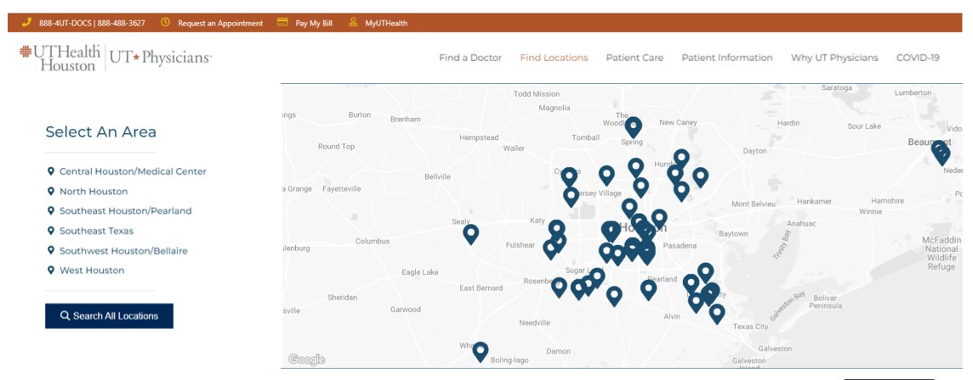


Slide 33


Slide 34


Slide 35
Thank you!

