Slide 1


Navigating the World of Insurance
May 2023

Slide 2
Objectives
Introduction
Understand common health insurance terminology and definitions
Understand the differences among various types of insurance plans
Suggested questions to ask your health plan
Non-covered services and other important information
Resources
Summary

Slide 3
Disclaimer
This presentation is for educational and informational purposes only.
It is not intended as a substitute for professional advice or to endorse or promote any one health care program or company over others.
All content is current as of May 1, 2023, and is subject to change in the future.

Slide 4
Introduction
Understanding available health insurance options and how health insurance plans work can be challenging.
Research options available to you, select the best health insurance policy for your individual needs, then understand how benefits under your policy are applied before you receive medical treatment.
These are some general guidelines that will help you navigate the world of health insurance, regardless of which provider you visit.
The information in this presentation is applicable to employer-sponsored insurance and to insurance purchased on the federal exchange (also known as the “Marketplace”).

Slide 5
Terms and Definitions
Provider – A physician, mid-level practitioner, hospital, or other facility that provides health care services.
    Mid-level practitioner examples: Physician Assistant, Surgical Assistant, Advance Practice Nurse (Nurse Practitioner)
    Other facility examples: Physical Therapy clinic, Radiology facility
Network – An affiliated group of providers that a health plan enters into a contract with to provide health care services for its enrollees (also referred to as members or subscribers).
    In-network – Providers who hold a contract with a health plan.
    Out-of-network – Providers who are not contracted with a health plan.
    You will pay more out-of-pocket when visiting out-of-network providers.
      It is best to understand your financial responsibility before deciding to receive out-of-network health care services.

Slide 6
Terms and Definitions
Network Service Area – The specific geographic area that a health plan manages (sells insurance to enrollees, and contracts with providers).
    A network service area is usually defined by a collection of counties.
Referral – The process of sending a patient from one provider to another for health care services. Referrals can work in one of two ways:
      Your health plan might require that your assigned primary care physician contact the health plan for a referral number.
      Your health plan might allow your primary care physician to “OK” the referral. In this case, it could be a written order or a verbal OK from the primary care physician for you to see another provider.
  In many plans that require a primary care physician referral, it is required that a referral be in place before a patient receives care from any other provider.
    Without a required referral in place, the health plan will not pay the provider for the services.

Slide 7
Terms and Definitions
Authorization – (also referred to as precertification, preauthorization, or notification) – Required health plan approval prior to receiving covered health care services.
  Examples of services requiring authorization may include and are not limited to:
    Inpatient hospitalization
    MRIs, CT or Pet Scans
    Outpatient surgery
    Chemotherapy
    Certain pharmaceuticals
  Without authorization by the health plan for procedures requiring it, the health plan will not pay the provider for the services.

Slide 8
Terms and Definitions
Predetermination – An optional administrative procedure where a provider submits a written request to a patient’s health plan to confirm coverage before a specific, planned procedure.
  Predeterminations are done primarily for services that may not usually be a covered benefit; for example, procedures the health plan classifies as experimental, investigational, or cosmetic.
  The goal of a predetermination response is written confirmation from the health plan that the procedure is medically necessary and will be covered under a patient’s benefit plan.
  If it is not covered, you will know this up front and decide whether to proceed with a service.
  The health plan may send you a letter in response to a provider’s predetermination request. Be sure to share this letter with your provider.

Slide 9
Terms and Definitions
Explanation of Benefits (EOB) – An explanation of how your plan benefits are applied and how much (if any) you will owe your provider.
  The EOB is not a bill requesting payment.
Birthday Rule – The process used to determine primary and secondary coverage for children, if parents cover children under two policies.
  The parent whose birthday occurs first in a calendar year is considered the primary insurance.

Slide 10
Terms and Definitions
Coordination of Benefits (COB) – The process for determining the financial responsibilities of two or more employer-based policies. Be sure to inform your providers if you have more than one insurance policy.
  Example: If you have a Blue Cross plan for your primary insurance, and another Blue Cross or a different company plan as your secondary insurance, the provider will submit the claim first to the primary Blue Cross plan.
    Blue Cross processes the claim.
    After the provider receives the explanation of benefits (EOB), the provider will send a claim to the secondary plan with a copy of Blue Cross’s EOB for additional payment, if applicable.
  You cannot pick which health plan is primary.
  COB normally follows the rules of the primary health plan.
  COB is not done for two individual policies.

Slide 11
Terms and Definitions
Essential Health Benefits – As defined by the Affordable Care Act: Essential health benefits are a set of 10 categories of services that Marketplace health plans are required to cover.
https://www.healthcare.gov/glossary/essential-health-benefits/
  Ambulatory patient services (outpatient care you get without being admitted to a hospital)
  Emergency services
  Hospitalization (like surgery and overnight stays)
  Pregnancy, maternity, and newborn care (before and after birth)
  Mental health and substance use disorder services, including behavioral health treatment (includes counseling and psychotherapy)
  Prescription drugs
  Rehabilitative and habilitative services and devices (services and devices to help people with injuries, disabilities, or chronic conditions gain or recover mental and physical skills)
  Laboratory services
  Preventive and wellness services, and chronic disease management
  Pediatric services, including oral and vision care (but adult dental and vision coverage aren’t essential health benefits)

Slide 12
Terms and Definitions
Co-payment (or Co-pay) - A set dollar amount due at the time of service.
  A co-pay applies to specific services as outlined by your health plan.
  It may apply per visit, per day, per specialty, or per Tax ID (varies by plan).
Deductible – A set dollar amount owed during the course of the policy year.
  A deductible applies to specific services as outlined by your health plan.
  You pay your deductible first, before your health plan starts to pay its portion (its co-insurance).
Co-insurance - A cost-sharing expense between you and your health plan after you pay your deductible.

Slide 13
Terms and Definitions
Out of Pocket Maximum (OOP) - The maximum dollar amount you are responsible for paying “out of your pocket” each coverage year for covered, in-network services.
  The OOP maximum may include a combination of co-payments, deductibles and/or co-insurance (specifics vary by plan).
Annual Maximum - The maximum dollar amount your health plan will pay for covered services during the policy year.
  Example: If your policy states the annual maximum is $100,000, this means the policy will not pay out more than $100,000 during the policy year.
  Effective with new or renewing policies on/after 1/1/2014, the Affordable Care Act prohibits health plans from setting annual maximums on essential health benefits.
  Health plans can still impose annual maximums on services that are not considered essential health benefits.

Slide 14
Terms and Definitions
Lifetime Maximum - The maximum dollar amount your health plan will pay for covered services during the “life” of the plan.
  Example: If your plan states the lifetime maximum is $1 million, this means the plan will not pay out more than $1 million as long as you are enrolled under the same plan.
  Effective with new or renewing plans written on/after 9/23/2010, the Affordable Care Act prohibits insurance companies from setting a lifetime maximum on essential health benefits for the time consumers are enrolled under that plan.
  Health plans can still impose lifetime maximums on services that are not considered essential health benefits.

Slide 15
Terms and Definitions
Fully Insured (a.k.a. fully-funded, or state-regulated) – The health plan bears the financial responsibility of administering benefits, administration costs, and guaranteeing claim payments.
  The Texas Department of Insurance (TDI) regulates and sets requirements for fully-insured health plans that are licensed in Texas.
    Complaints and appeals from patients and providers can be directed to the TDI.
  Think of this as a “base model” health plan – employers can add covered services to the base policy, but can’t modify or opt out of benefits, eliminate programs, etc.
  Marketplace plans are fully-insured.

Slide 16
Terms and Definitions
Self-Insured (a.k.a. self-funded, or Administrative Services Only) – The employer bears the financial responsibility of claim payments.
Large employer groups generally favor this arrangement.
This arrangement includes setting up a fund from which claim payments are made, and all other administrative aspects of managing a benefit plan (administering benefits, claims processing, utilization management, etc.) are handled by the health plan.
Self-insured policies are exempt from state regulation (TDI) and also from any reform activities undertaken at the state level.
The Employee Retirement Income Security Act of 1974 (ERISA) regulates the operation of self-insured health plans.
  Complaints and appeals from patients and providers can be directed to the employer.
Think of this as a “custom designed” health plan – employers can add to or remove covered benefits, eliminate programs, etc.

Slide 17
Individual and Family Deductible and Co-Insurance Examples

Slide 18
Individual Deductible and Co-insurance Example
Your plan, together with your amount due, reimburses your provider $800 for a procedure.
You have a $500 deductible and your co-insurance is 20%.

Slide 19
Individual Deductible and Co-insurance Example
Your plan, together with your amount due, reimburses your provider $800 for a procedure.
You have a $500 deductible and your co-insurance is 20%.
  $800.00 (the amount paid by patient and insurance)
  -500.00 (your deductible owed) = $300.00 remaining
  $300 x 20% co-insurance due = $60 (20% of $300).
  You owe your deductible plus 20% coinsurance = $560.00.
$800
- $500
$300
Reimbursement amount
Your deductible owed
Remaining amount due

Slide 20
Individual Deductible and Co-insurance Example
Your plan, together with your amount due, reimburses your provider $800 for a procedure.
You have a $500 deductible and your co-insurance is 20%.
  $800.00 (the amount paid by patient and insurance)
  -500.00 (your deductible owed) = $300.00 remaining
  $300 x 20% co-insurance due = $60 (20% of $300).
  You owe your deductible plus 20% coinsurance = $560.00.
$800
- $500
$300
Reimbursement amount
$300
x 20% $60
Remaining amount due
Your deductible owed
Co-insurance
Remaining amount due
Your co-insurance owed

Slide 21
Individual Deductible and Co-insurance Example
Your plan, together with your amount due, reimburses your provider $800 for a procedure.
You have a $500 deductible and your co-insurance is 20%.
  $800.00 (the amount paid by patient and insurance)
  -500.00 (your deductible owed) = $300.00 remaining
  $300 x 20% co-insurance due = $60 (20% of $300).
  You owe your deductible plus 20% coinsurance = $560.00.
$800
- $500
$300
Reimbursement amount
$300
x 20% $60
Remaining amount due
Your deductible owed
Co-insurance
Remaining amount due
Your co-insurance owed
$500
+ $60
$560
Your deductible owed
Your co-insurance due
Total patient responsibility

Slide 22
Individual with Family Deductible Example
A family of five has individual deductibles of $500 each and a family deductible of $1,500.
This scenario applies to covered, in-network services.

Slide 23
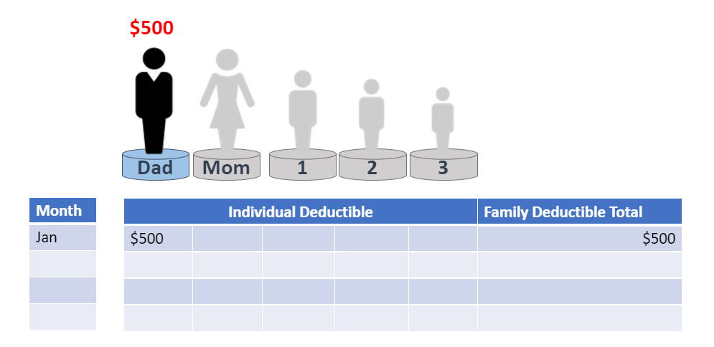
Individual with Family Deductible Example

Slide 24
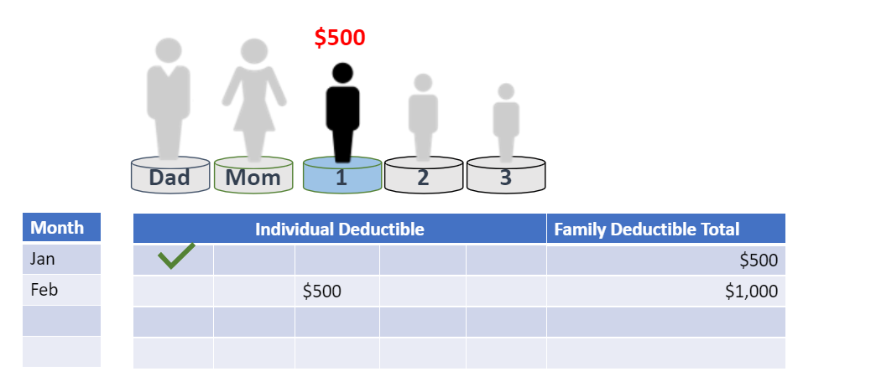
Individual with Family Deductible Example

Slide 25
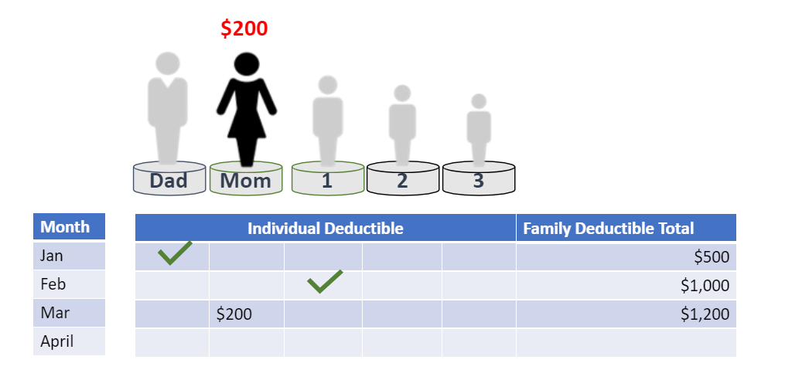
Individual with Family Deductible Example

Slide 26
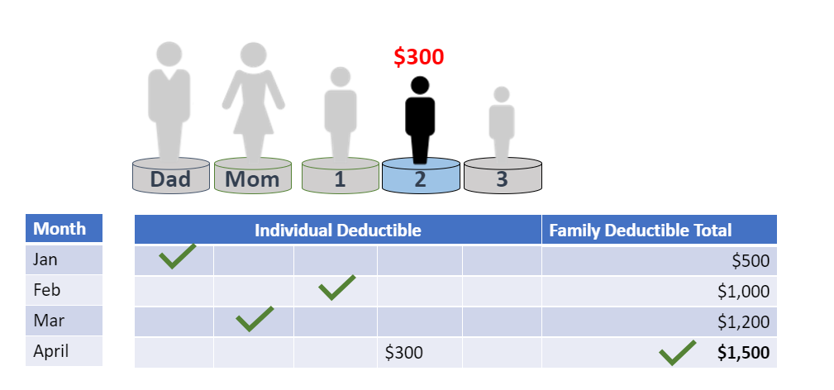
Individual with Family Deductible Example
The family deductible is now met.
Even though Mom and Child Two didn’t meet their individual deductibles, and Child Three has not yet had services, the individual and family deductibles are no longer required for anyone for the remainder of the plan year.

Slide 27
Insurance Plan Types

Slide 28
Insurance Plan Types (not all-inclusive)
Managed Care plans
  Health Maintenance Organization (HMO)
  Preferred Provider Organization (PPO)
  Point-Of-Service (POS)
  Exclusive Provider Organization (EPO)
Indemnity plans

Slide 29
HMO = Health Maintenance Organization
An HMO plan provides a wide range of comprehensive health care services.
You will generally have to choose a primary care physician who is part of the HMO plan and serves as the “gatekeeper” for all your medical care.
Primary care physician referrals to specialists who work with the HMO are generally required (varies by plan).
An HMO plan usually has limited or no out-of-network benefits.
Generally, an HMO is more affordable than other plan types with more flexibility.
You are responsible for any co-pays, deductibles and/or co-insurance as required by your plan.

Slide 30
PPO = Preferred Provider Organization
A PPO plan also provides a wide range of comprehensive health care services.
A PPO plan works with specific providers, also known as “preferred providers.”
There is no primary care physician assignment; therefore, a primary care physician referral to see a specialist is not required, and you can go directly to any specialist.
If you visit a provider who doesn’t work with the PPO network, you will pay a higher amount than if you remain with providers who work with the PPO.
Because a PPO plan allows in and out-of-network access, the costs may be higher than an HMO.
You are responsible for any co-pays, deductibles and/or co-insurance as required by your plan.

Slide 31
POS = Point of Service
A POS plan is a type of managed care plan which allows you a choice to use a provider who works with the POS plan, or go outside the plan.
A primary care physician may be required (varies by plan).
If you visit a provider who works with the POS plan, you will pay less than if you visit a provider who is not part of the POS plan.
Because a POS plan allows in and out-of-network access, the costs may be higher than an HMO.
You are responsible for any co-pays, deductibles and/or co-insurance as required by your plan.

Slide 32
EPO = Exclusive Provider Organization
Similar to an HMO, an EPO plan is a managed care plan which uses a network of providers and may include a primary care physician assignment.
A primary care physician referral may be required (varies by plan).
An EPO’s network may be a custom provider network that the health plan creates for an employer group.
  The network may be even more limited than an HMO, PPO, or POS plan.
An EPO plan may have limited or no out-of-network benefits.
Because an EPO may have a smaller provider network, the costs may be lower than a PPO or a POS plan.
You are responsible for any co-pays, deductibles and/or co-insurance as required by your plan.

Slide 33
Indemnity
Indemnity insurance is traditional health insurance (also known as a “fee for service” plan) through which the insured person is reimbursed for covered medical expenses after meeting a deductible.
These plans allow the policyholder to choose whichever doctor or other health care service provider they wish.
It allows the greatest amount of flexibility and freedom in a health insurance plan, and is typically expensive in terms of monthly premiums as well as other out of pocket costs that would be required.

Slide 34
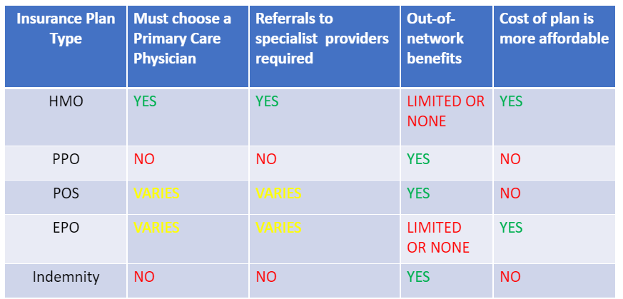
Knowledge Check
Disclaimer: these are high-level, general attributes of these plan types.
Different insurance companies may offer variations in plan design.

Slide 35
Consumer-Driven
Health Plans

Slide 36
Consumer-Driven Health Plans
The concept of CDHPs began in the 1990s, as employers and insurance plans looked for ways to streamline their costs.
These policies were designed to make people more accountable for their health care and expenses.
    Health Savings Account (HSA)
    An HSA is a type of personal savings account you can set up to pay certain health care costs. It allows you to put money away and withdraw it tax-free, as long as you use it for qualified medical expenses, like deductibles, co-payments, co-insurance, and more.
    Health Reimbursement Account (HRA)
      An HRA is an account that your employer funds, and you can reimburse yourself for certain medical, dental or vision expenses.

Slide 37
Consumer-Driven Health Plans
    Flexible Spending Account (FSA)
      An FSA is a special account you put money into that you use to pay for certain out-of-pocket health care costs. You don't pay taxes on this money.
  Note: Specific qualified medical expenses for all CDHPs vary by plan.
  Which option is available to you through your employer and might be right for you?

Slide 38
High-Deductible Health Plans (HDHPs)
A HDHP is a plan with a higher deductible than a traditional insurance plan.
The monthly premium is usually lower, but you pay more health care costs yourself (deductible) before the insurance company starts to pay its share (co-insurance).
An HDHP can be combined with a health savings account, allowing you to pay for certain medical expenses with money you don’t pay taxes on.

Slide 39
High-Deductible Health Plans (HDHPs)
For 2023, the IRS defines a high deductible health plan as any plan with a deductible of at least $1,500 for an individual or $3,000 for a family.
A HDHP’s total yearly out-of-pocket expenses (including deductibles, co-payments, and co-insurance) for covered, in-network services can’t be more than $7,500 for an individual or $15,000 for a family.
Resource - https://www.irs.gov/pub/irs-drop/rp-22-24.pdf

Slide 40
Suggested questions to ask your health plan

Slide 41
Questions to Ask
If you don’t know the answers to these questions, ask your health plan!
  What is the full plan name (brand name)?
  What is the product (i.e., HMO, PPO, POS, EPO)?
  Is the plan fully-insured or self-insured?
  Does the plan offer both in and out-of-network benefits?

Slide 42
Questions to Ask
If you are scheduled for a procedure in the doctor’s office, at an inpatient or outpatient hospital setting, in a free-standing facility (like a radiology facility, physical therapy clinic, outpatient surgery center, etc.), ask about specific financial information:
  Will I owe a co-pay?
  Will I owe a deductible?
  Will co-insurance apply after I meet my deductible?
  Will any charges go toward my maximum out-of-pocket responsibility?
Remember: for the highest level of benefits, visit an in-network provider.
If you are considering visiting an out-of-network provider, ask: What is my coverage level if I visit (out-of-network provider)? Then, get the answers to the specific financial questions above.

Slide 43
Questions to Ask
  Lifetime, Annual and Service Maximums
  If you will have many physician or hospital visits through the course of a plan year, ask these questions:
  Is there a lifetime or annual maximum and is it renewed each plan year?
  What is my out-of-pocket maximum?
  Are there any service maximums? (Examples: chemotherapy, physical therapy). Sometimes, plans will impose a dollar limit on the amount they will pay out for a particular service per policy year.
    If yes, ask: What is the maximum? Is it part of or separate from the lifetime maximum?

Slide 44
Questions to Ask
  Pharmaceuticals/medications
  Contact your pharmacy benefit manager with these questions:
  What is my outpatient pharmacy coverage for (pharmaceutical)?
  Will (pharmaceutical) be covered for my diagnosis? Whether the answer is yes or no, ask for the specific financial information covered in a previous slide.
    If the answer is no, ask: What is the process for getting (pharmaceutical) reviewed for coverage?
    If the answer is yes, ask: Is it covered under the medical or the pharmacy benefit?
    Ask: Is there a supply limit?

Slide 45
Non-covered services
Important Information
Resources

Slide 46
Non-covered services
You or your doctors may be told that a particular service is not covered under your plan.
There are generally written appeal channels to ask for review of coverage for a non-covered service:
  Fully-insured plans: through the insurance plan and TDI.
  Self-insured plans: through your employer.
Ask for a Benefit Plan Summary (may also be known as Certificate of Coverage or other name) from your health plan or your employer’s benefits office.
  This is a complete, detailed document that specifically outlines all covered and non-covered services.
Your doctors and other health care providers can help with your appeal by including clinical information describing why the service is medically necessary and is the best course of treatment for your medical situation.

Slide 47
Non-covered services
There are generally up to three appeal levels. The last appeal level may be sent to an independent outside organization known as an Independent Review Organization (IRO).
Keep copies of all letters sent and watch your mail!
  You’ll receive letters from your health plan or IRO with decisions and instructions and deadlines for the next level appeal.
Enlist help of family and/or friends through this process.
NOTE: Even with your best efforts, and all appeal channels exhausted when requesting coverage for a non-covered service, your health plan or employer group may continue to stand by its original decision.

Slide 48
Important Information
Non-medical or “gap” insurance policies
  These policies are not medical insurance plans. They are generally designed to help with other expenses (family needs, mortgage, groceries, travel expenses, etc.). Examples:
    Aflac
    American Fidelity
    Beazley
  Providers do not work with these policies. These policies pay cash directly to the policyholder.
Discount Cards
  Discount cards are not medical insurance plans.
  Providers may or may not accept discount cards.

Slide 49
Resources
Once you decide on a health insurance plan that meets your needs, there are many available resources to help you more fully understand its benefits:
  Refer to your benefits manual that you received when you enrolled in the plan.
  The Customer Service Department at your health plan is your advocate and will answer questions on how your benefits work.
Did you/your employer go through a broker (insurance agency) to purchase your policy?
  Brokers can assist you with your questions or issues.

Slide 50
Resources
Most major carriers offer a patient-specific website you can use to ask questions, review your benefits, check claims that have been processed & and other useful tools. Examples:
  Blue Cross Blue Shield of Texas: www.bcbstx.com/member
  UnitedHealthcare: www.myuhc.com
Texas Department of Insurance (TDI) website - for information pertaining to fully-insured (state-regulated) HMOs: https://www.tdi.texas.gov/hmo/index.html
Marketplace: https://www.healthcare.gov/

Slide 51
Summary
You are encouraged to ask your providers questions specific to your treatment options.
Get involved with your health care and understand your benefit coverage!
  Research your plan documents.
  Call your health plan with specific questions regarding your benefits on your decided course of treatment.
All health plans have a dedicated Customer Service phone number listed on the ID card and top of the EOB.
  Recommended: document the representative’s name, date, and ask for a call reference number.
  Most health plans offer secure websites where questions and answers can be addressed online, benefits and claims status checks can be done, and much more.

Slide 52
Summary
Work together with your providers, and become as knowledgeable as you can on your treatment options, benefits and coverage.
Share information with your doctors and other health care providers, so both sides are on the same page on how your benefits will be applied.

Slide 53
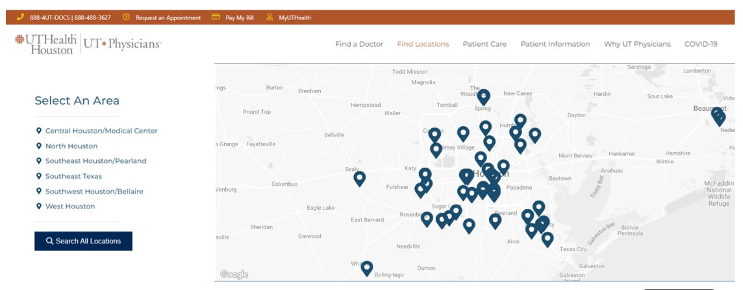


Slide 54
Thank you!

